Slide 1
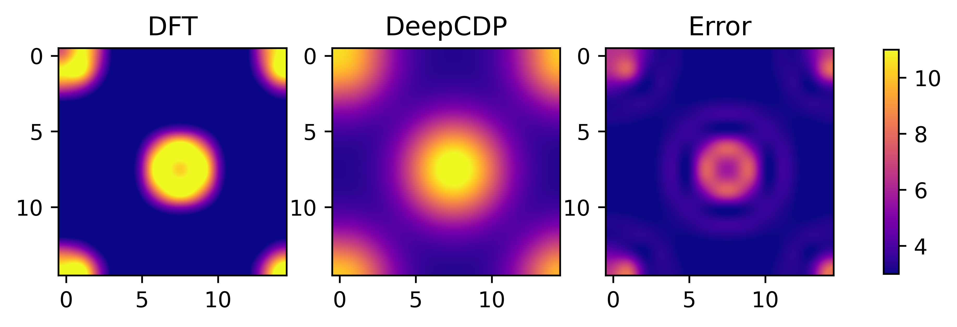
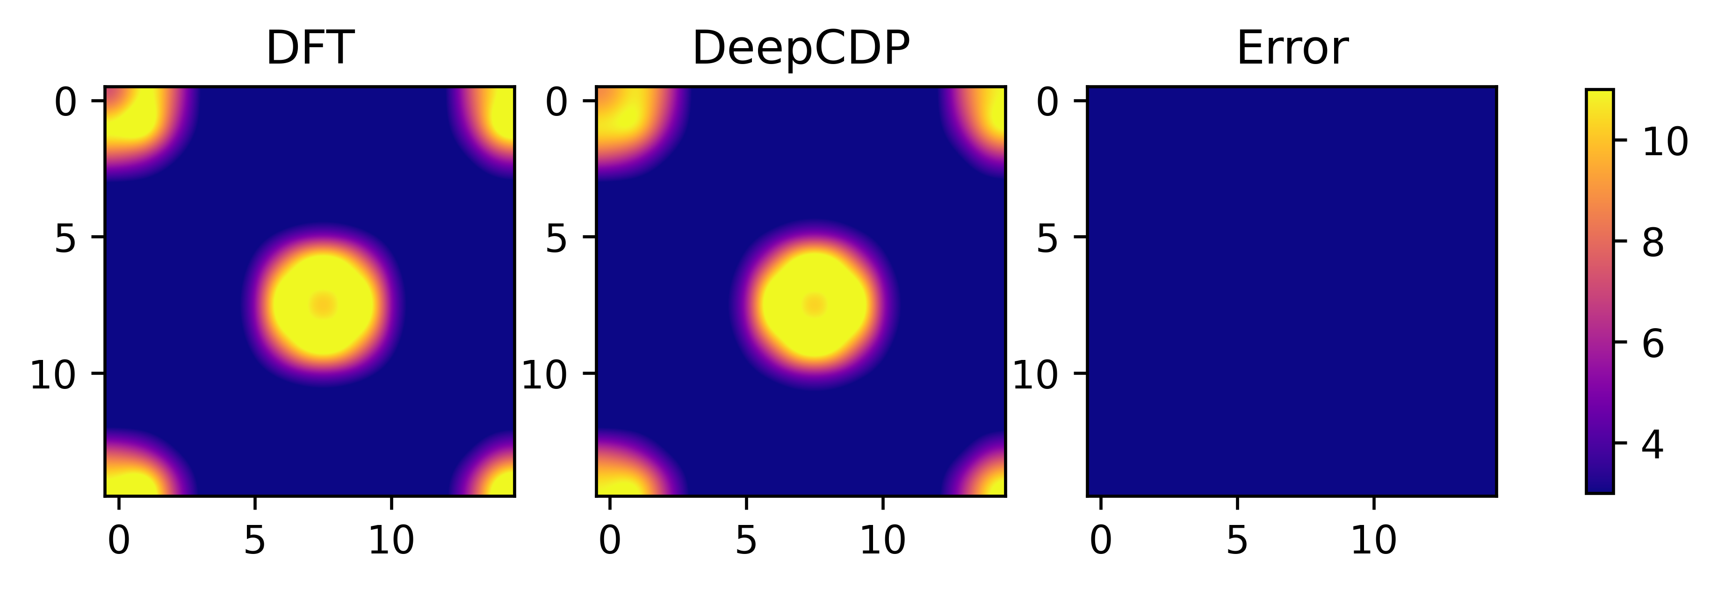
(a)
(b)

Slide 2
(a)
(b)
(c)

Slide 3
(a)
(b)

Slide 5
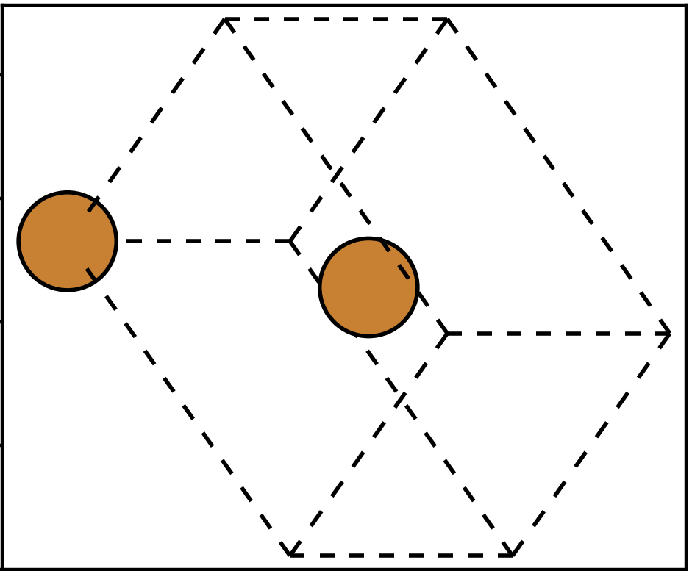
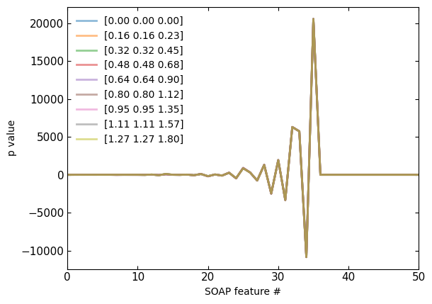
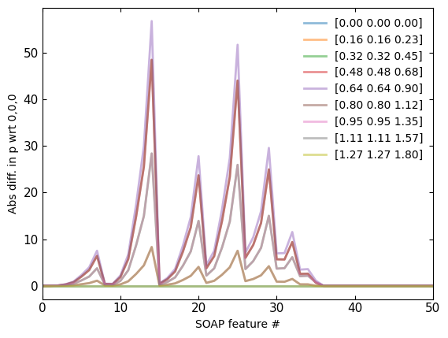
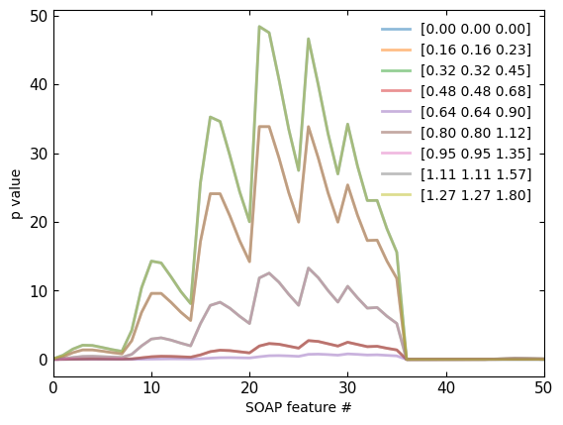
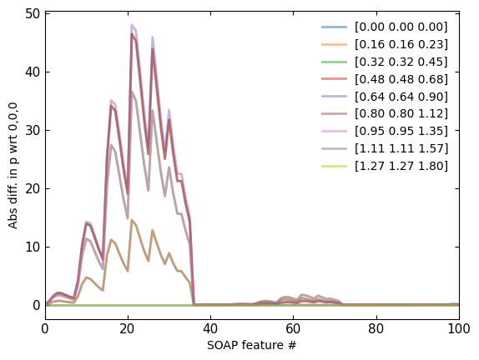
Non-weighted
Non-weighted
(b)
(c)
Weighted
Weighted
(d)
(e)
(a)

Slide 6
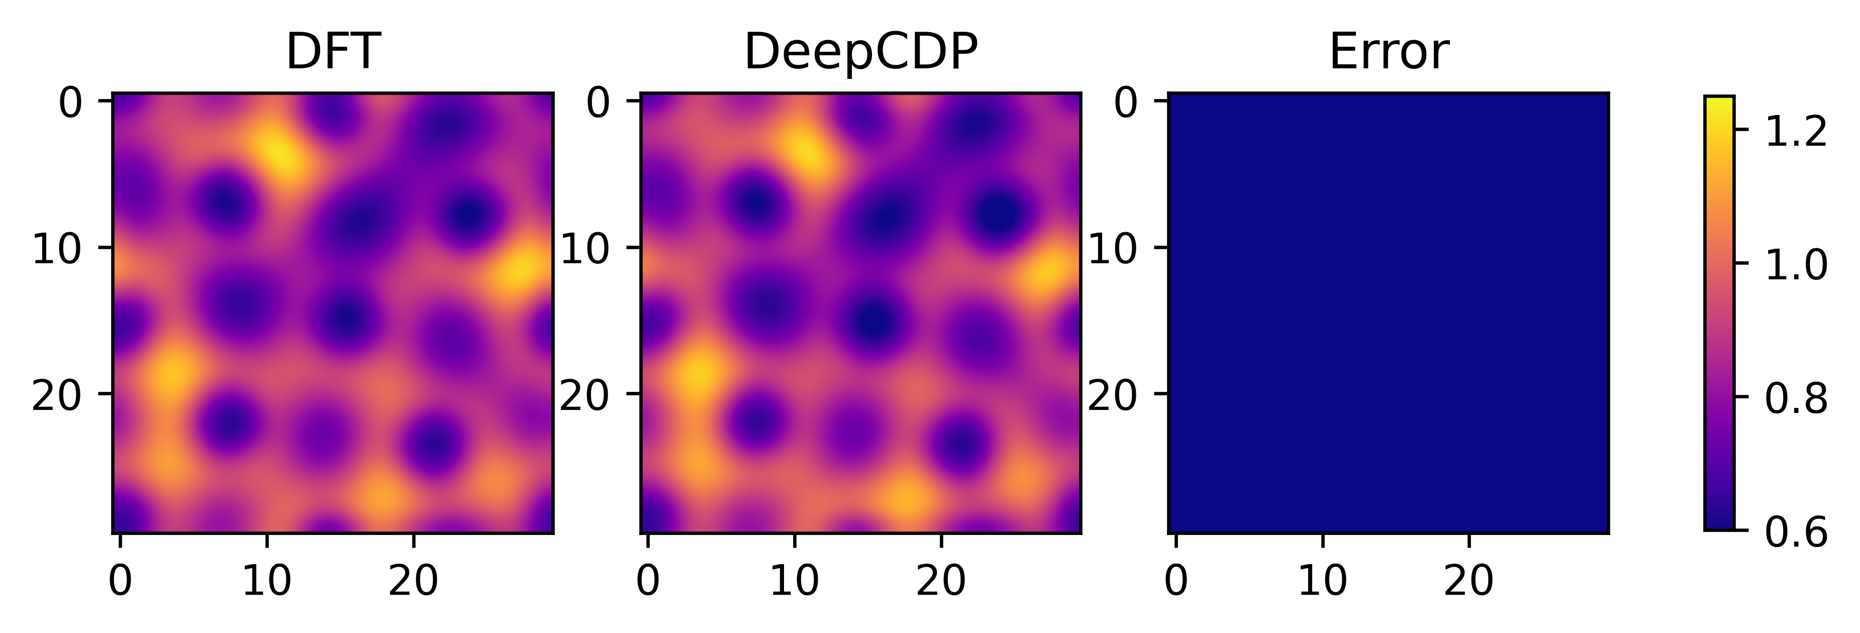
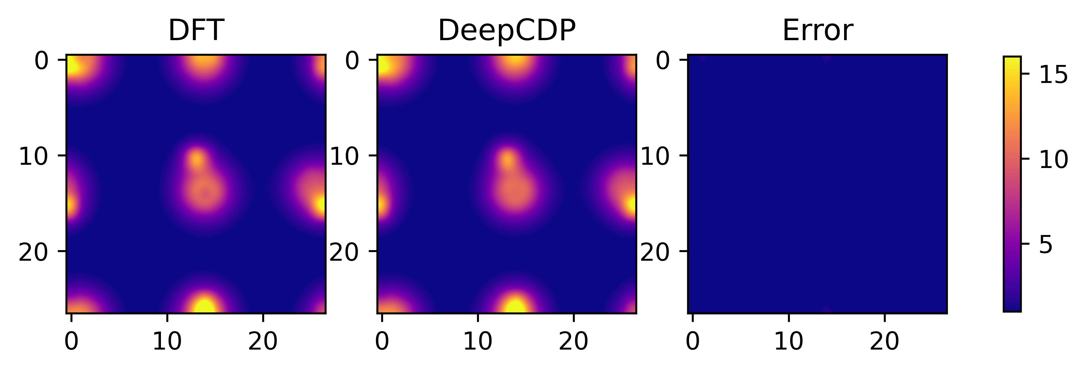
(a)
(b)

Slide 7
(d)
(e)

Slide 8
(a)
(b)
(c)

Slide 9
(a)
(b)
(c)

Slide 10
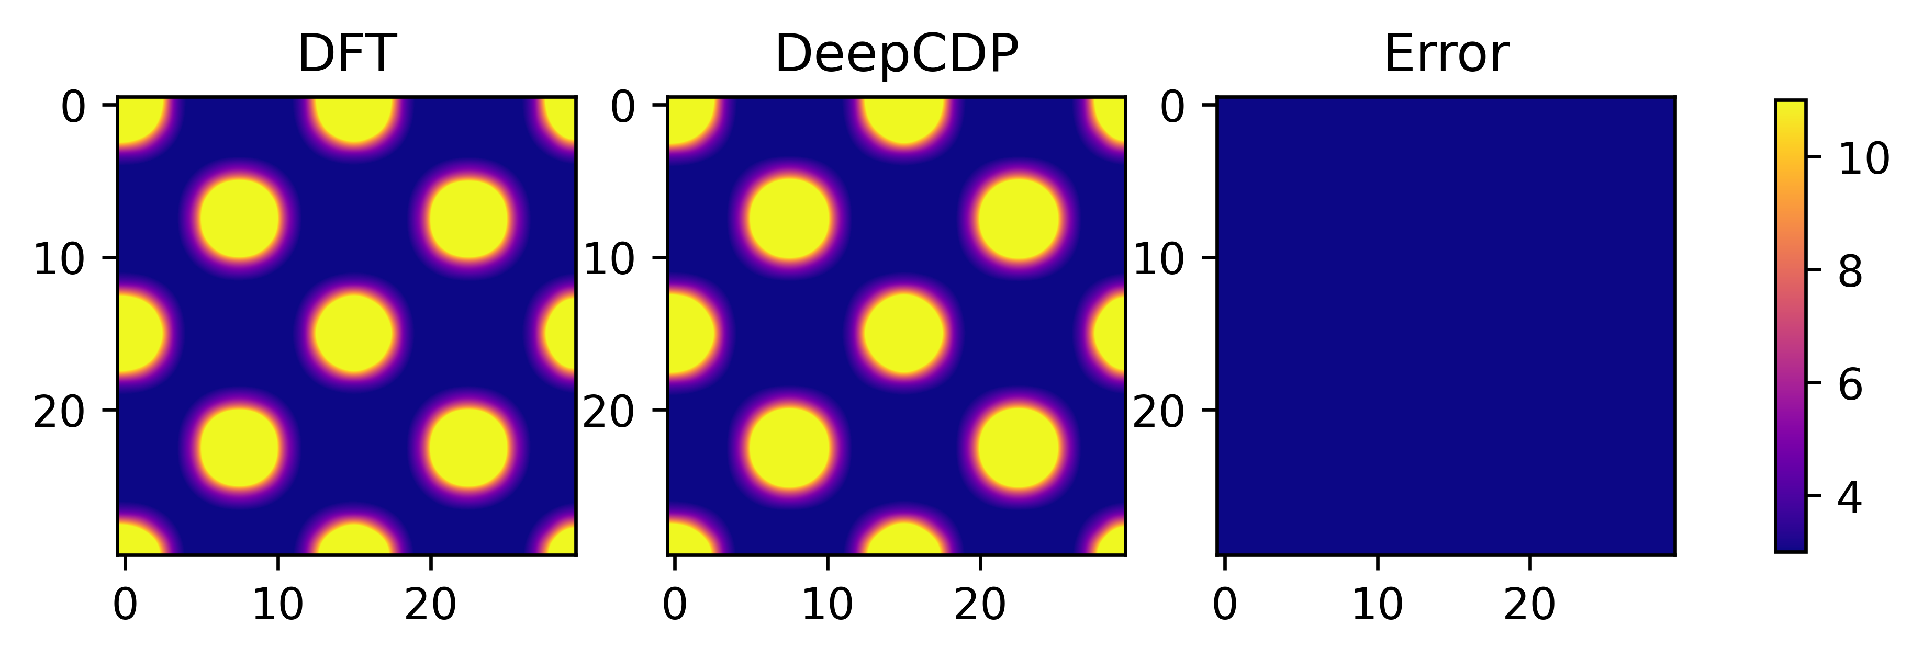
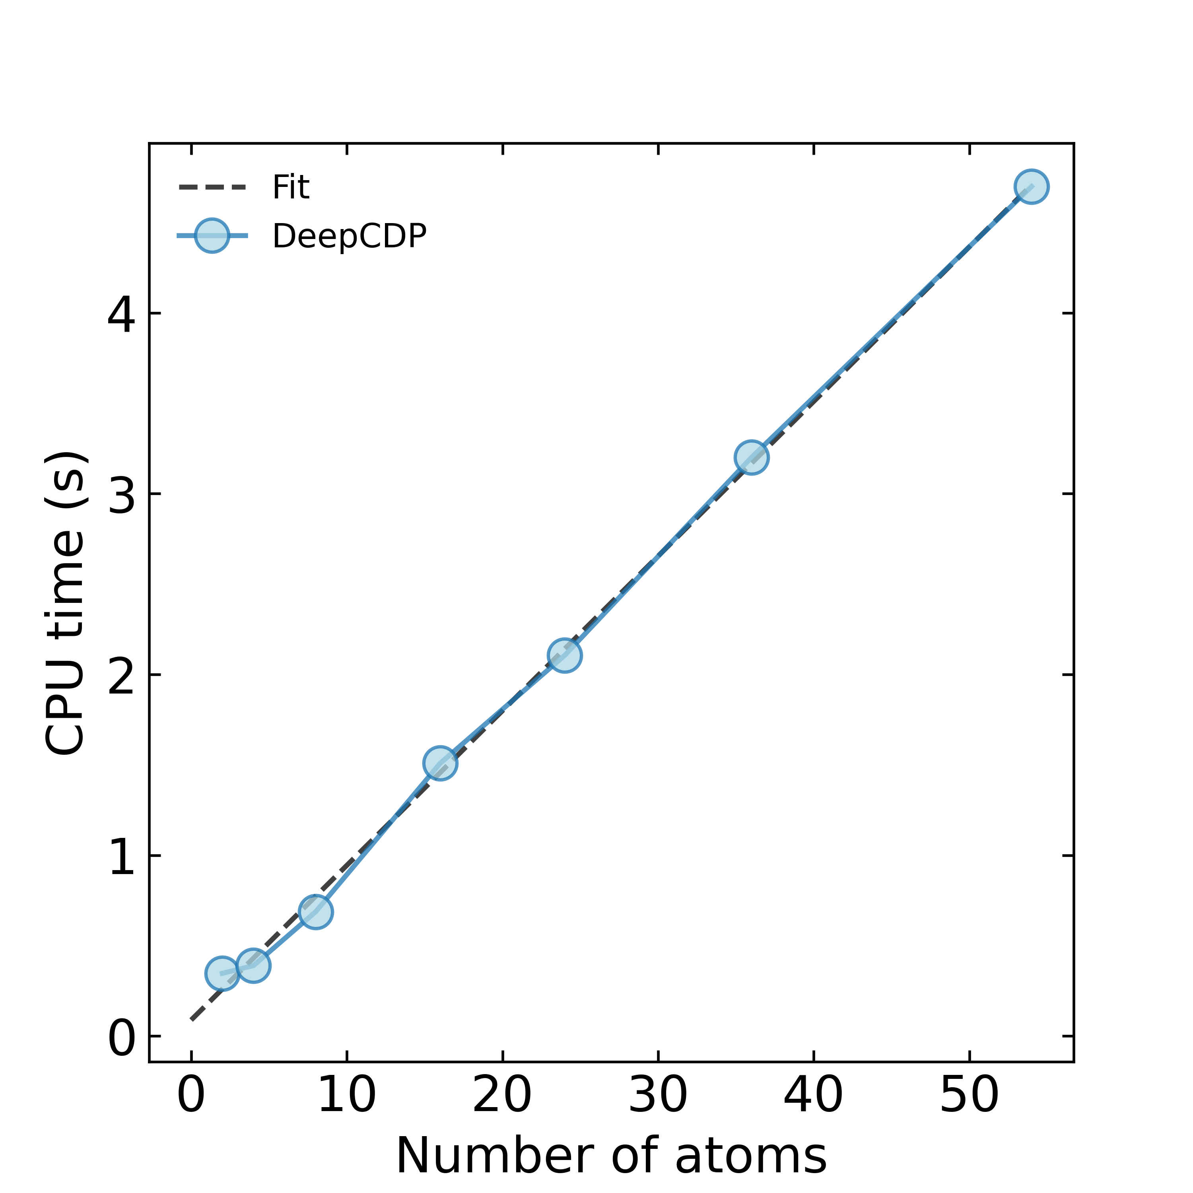
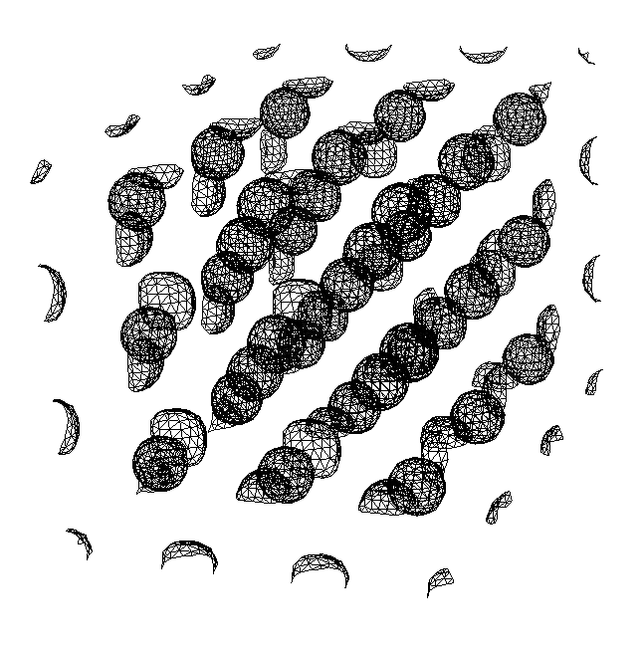
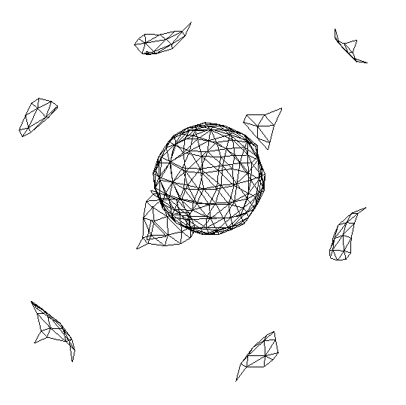
(a)
(b)
N = 54
N = 2
(N)

Slide 11
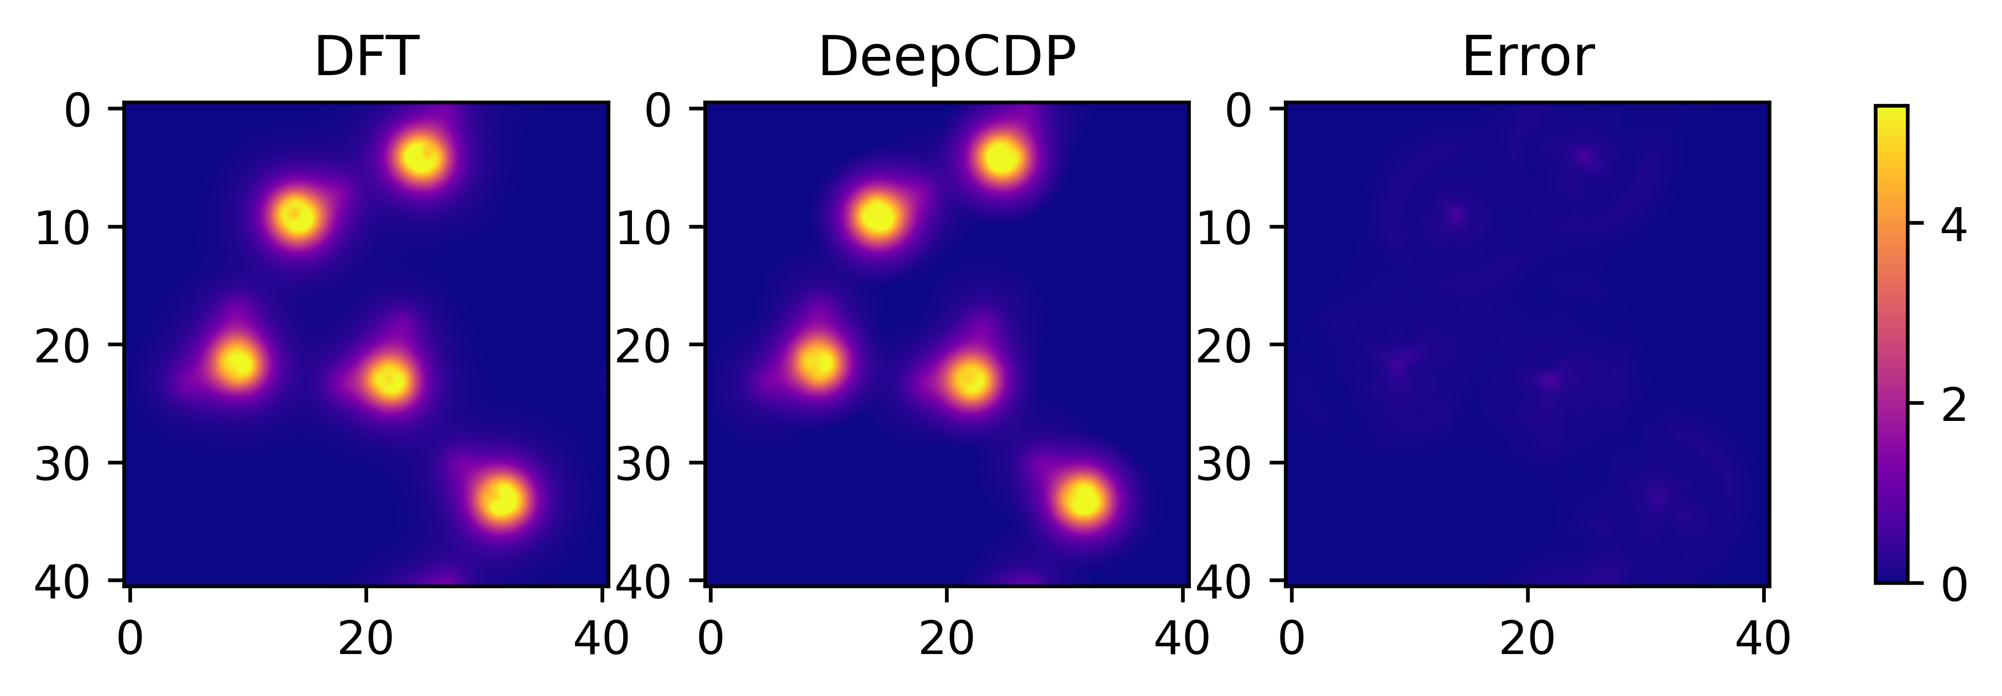
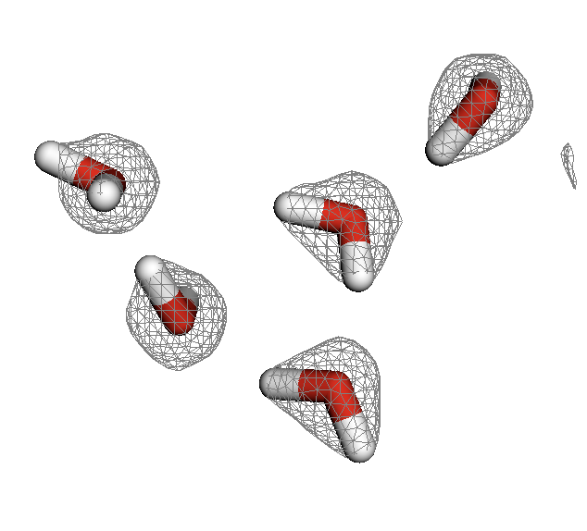
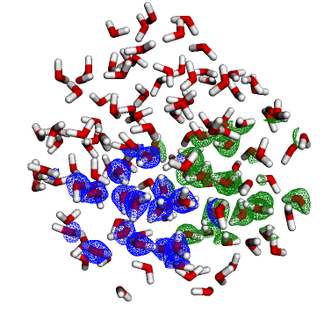
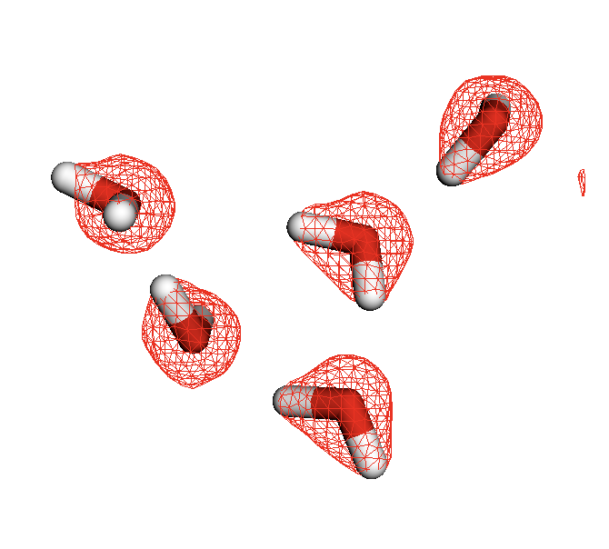
(a)
(b)
DFT
(c)
DeepCDP

Slide 12
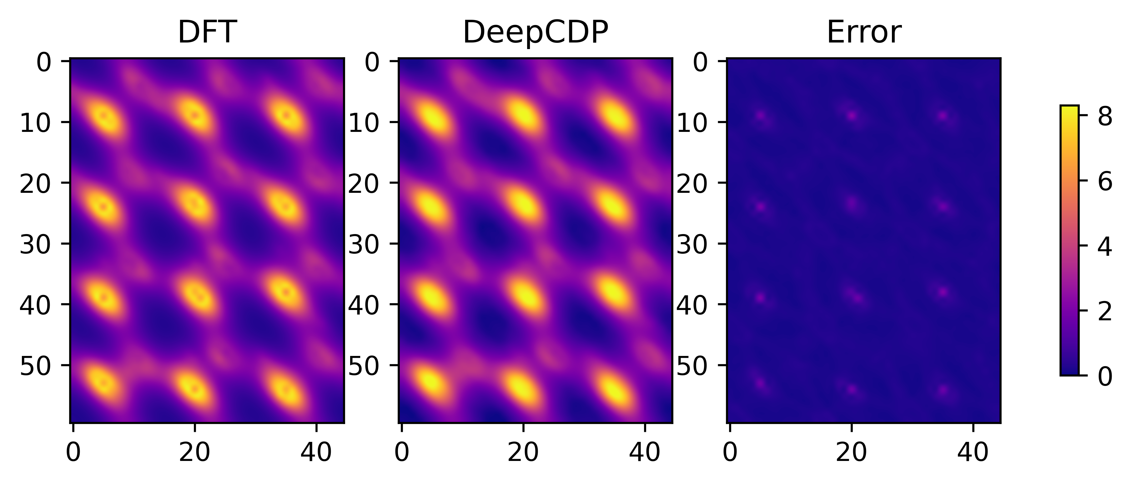
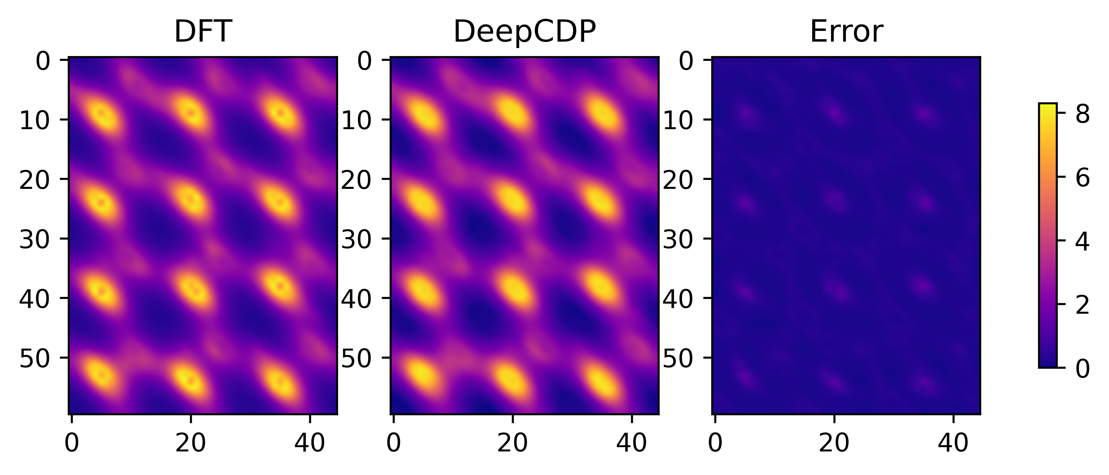
(a)
(b)
DeepCDP (u24C)
(c)
DeepCDP (c24C)

Slide 13
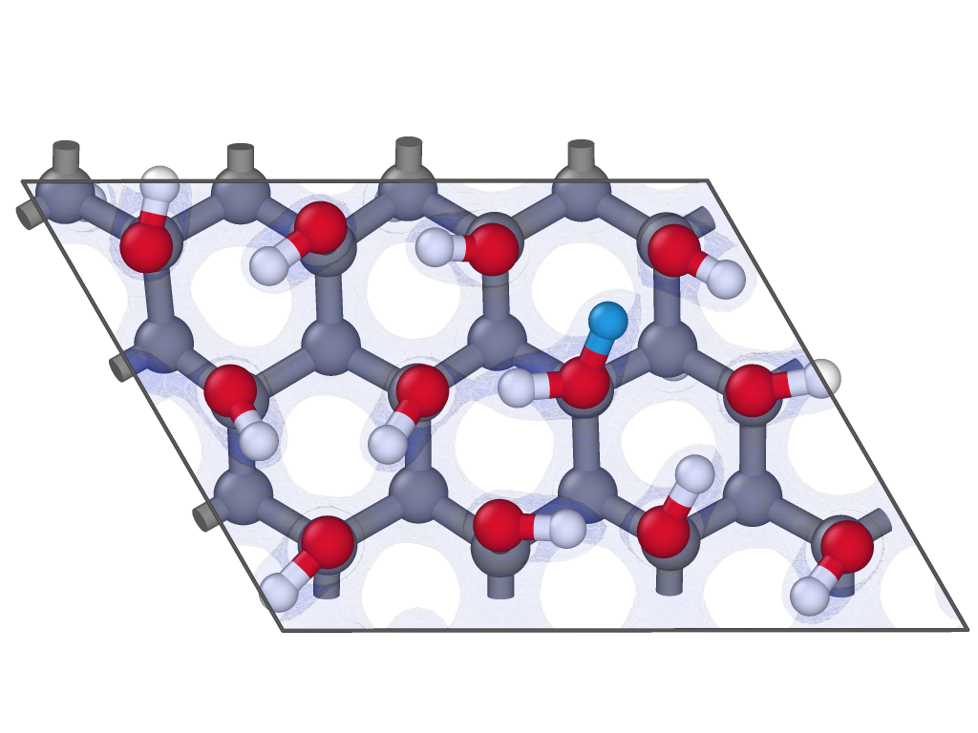
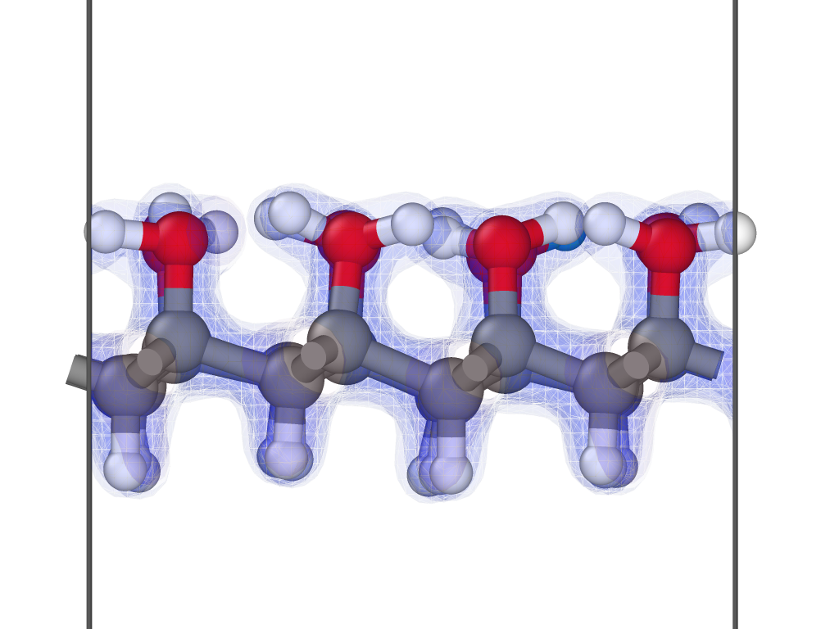
(a)
(b)
DeepCDP (u24C)
(c)
DeepCDP (c24C)

Slide 14
(a)
(b)
DeepCDP (u24C)
(c)
DeepCDP (c24C)

Slide 15
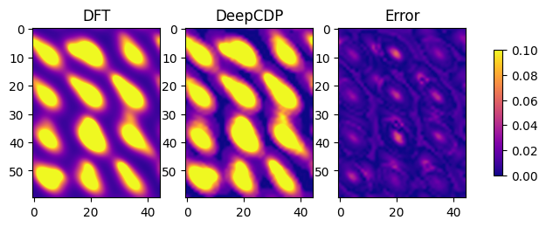


Slide 16
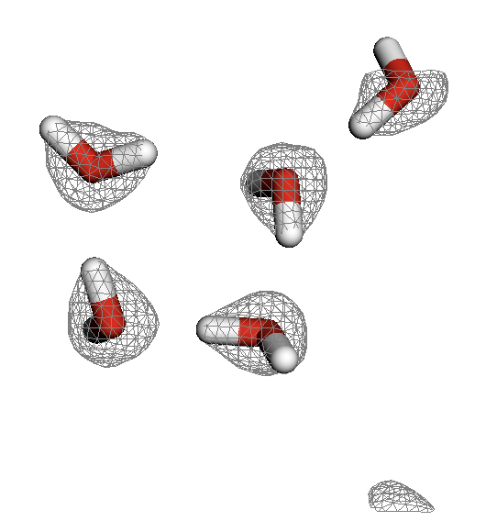
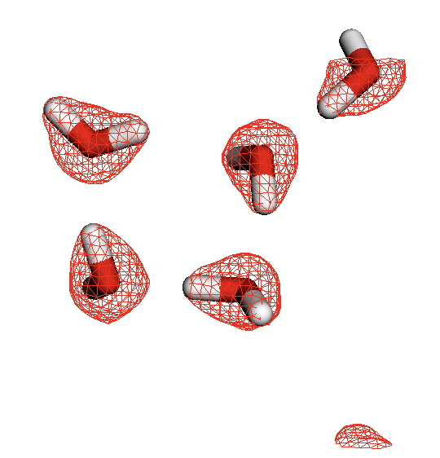

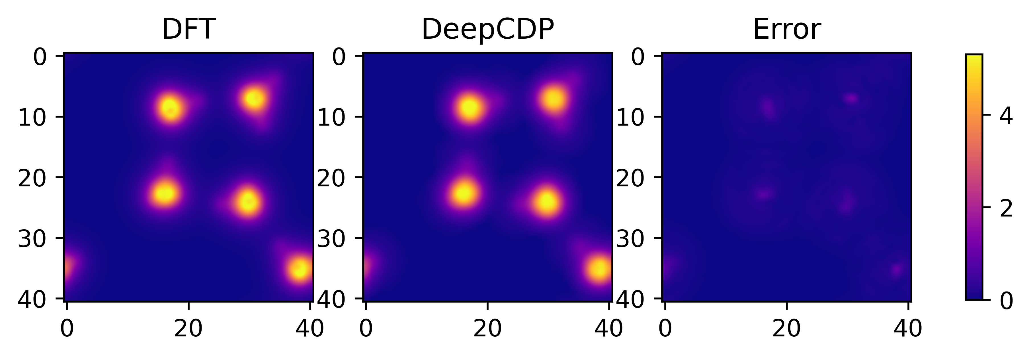
(a)
DFT
DeepCDP (c24C)
Error
(b)
DeepCDP (c24C)

Slide 17
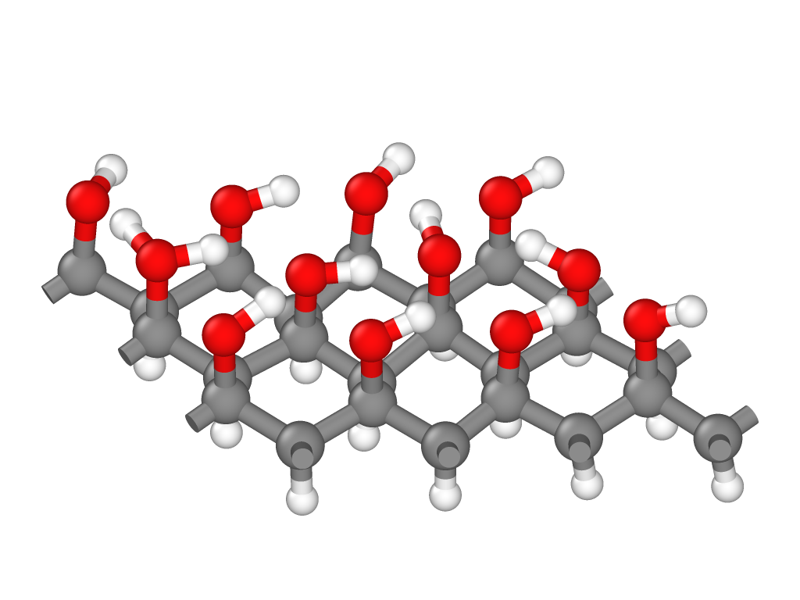





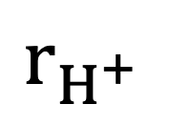








$$r_{H^{+}}$$
$$κ_{1}$$
$$κ_{3}$$
$$κ_{4}$$
$$κ_{2}$$
$$κ_{5}$$
$$κ_{8}$$
$$κ_{6}$$
$$κ_{9}$$
$$κ_{7}$$
$$κ_{10}$$
$$κ_{11}$$
$$κ_{12}$$
$$κ_{13}$$

Slide 18
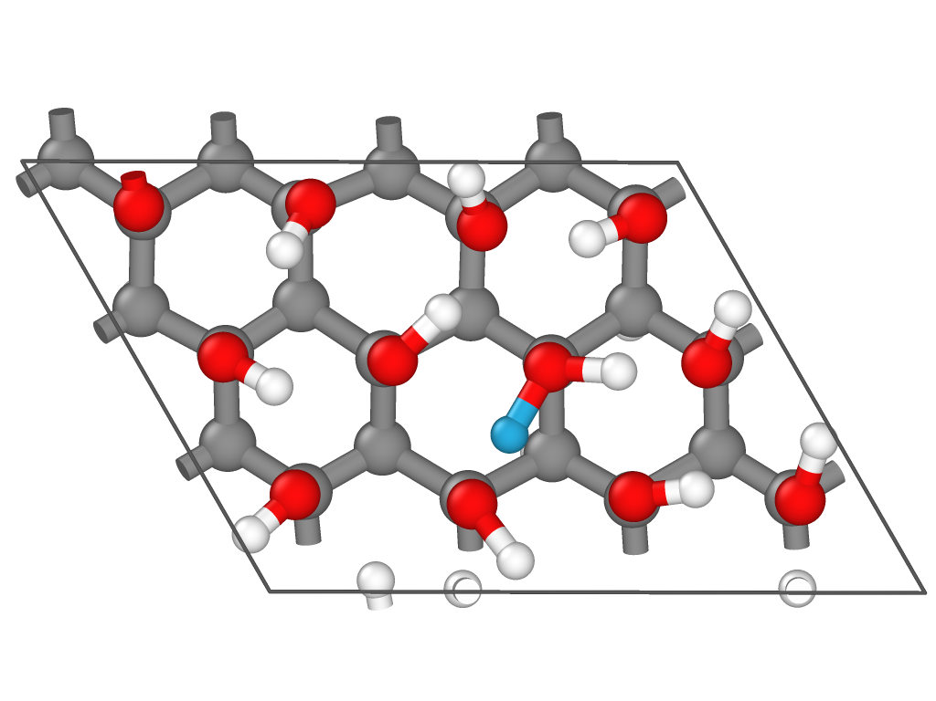
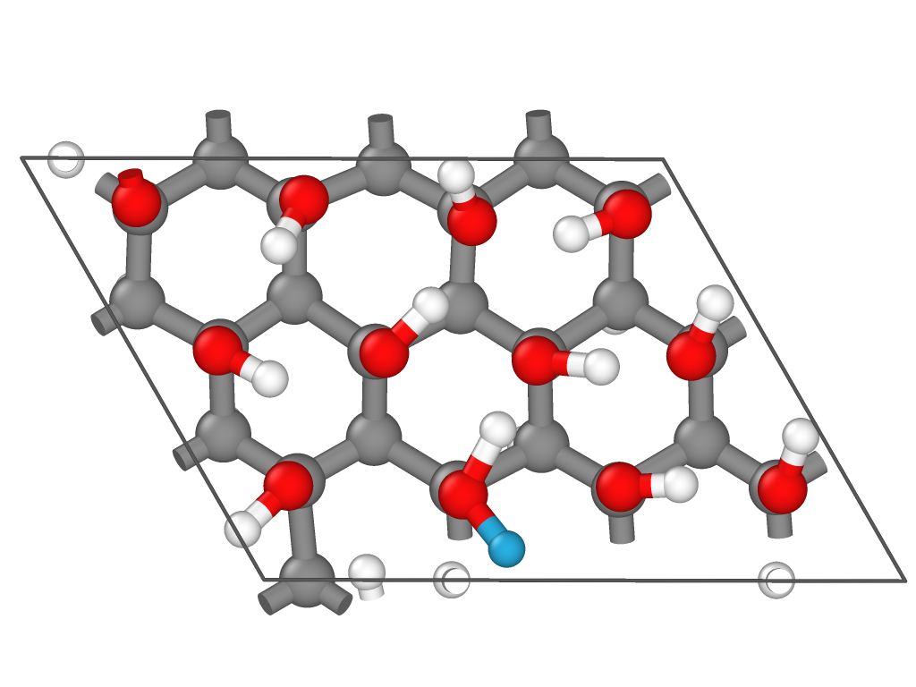
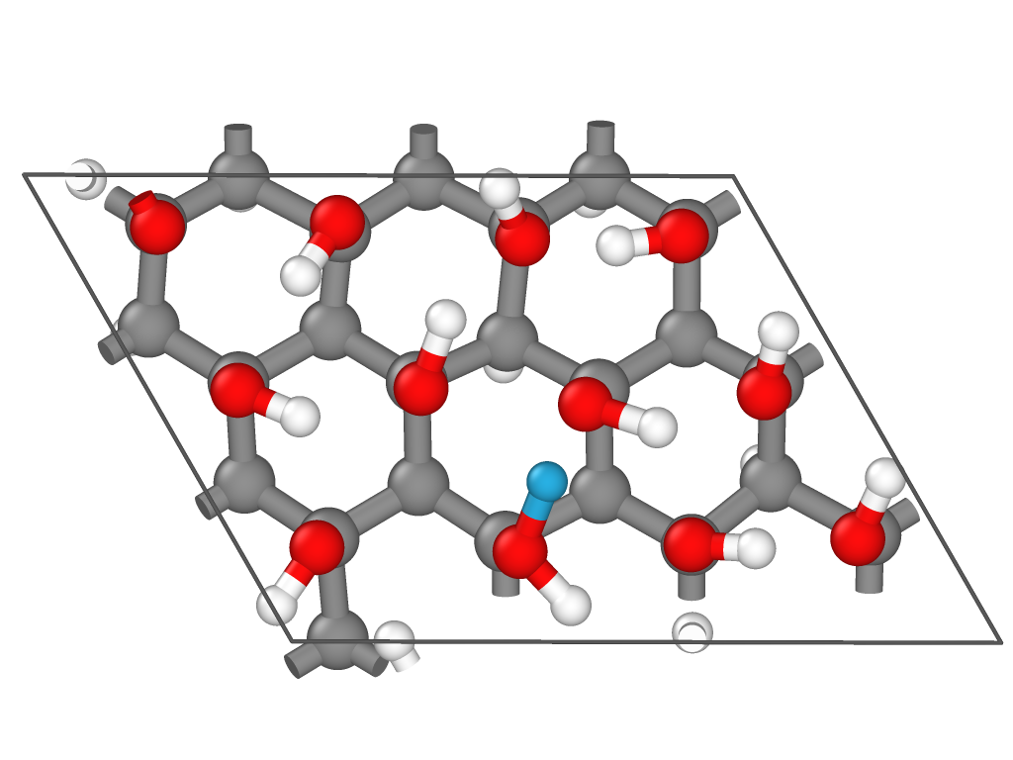
1
1
1
2
2
2
(a)
(b)
(c)

Slide 19
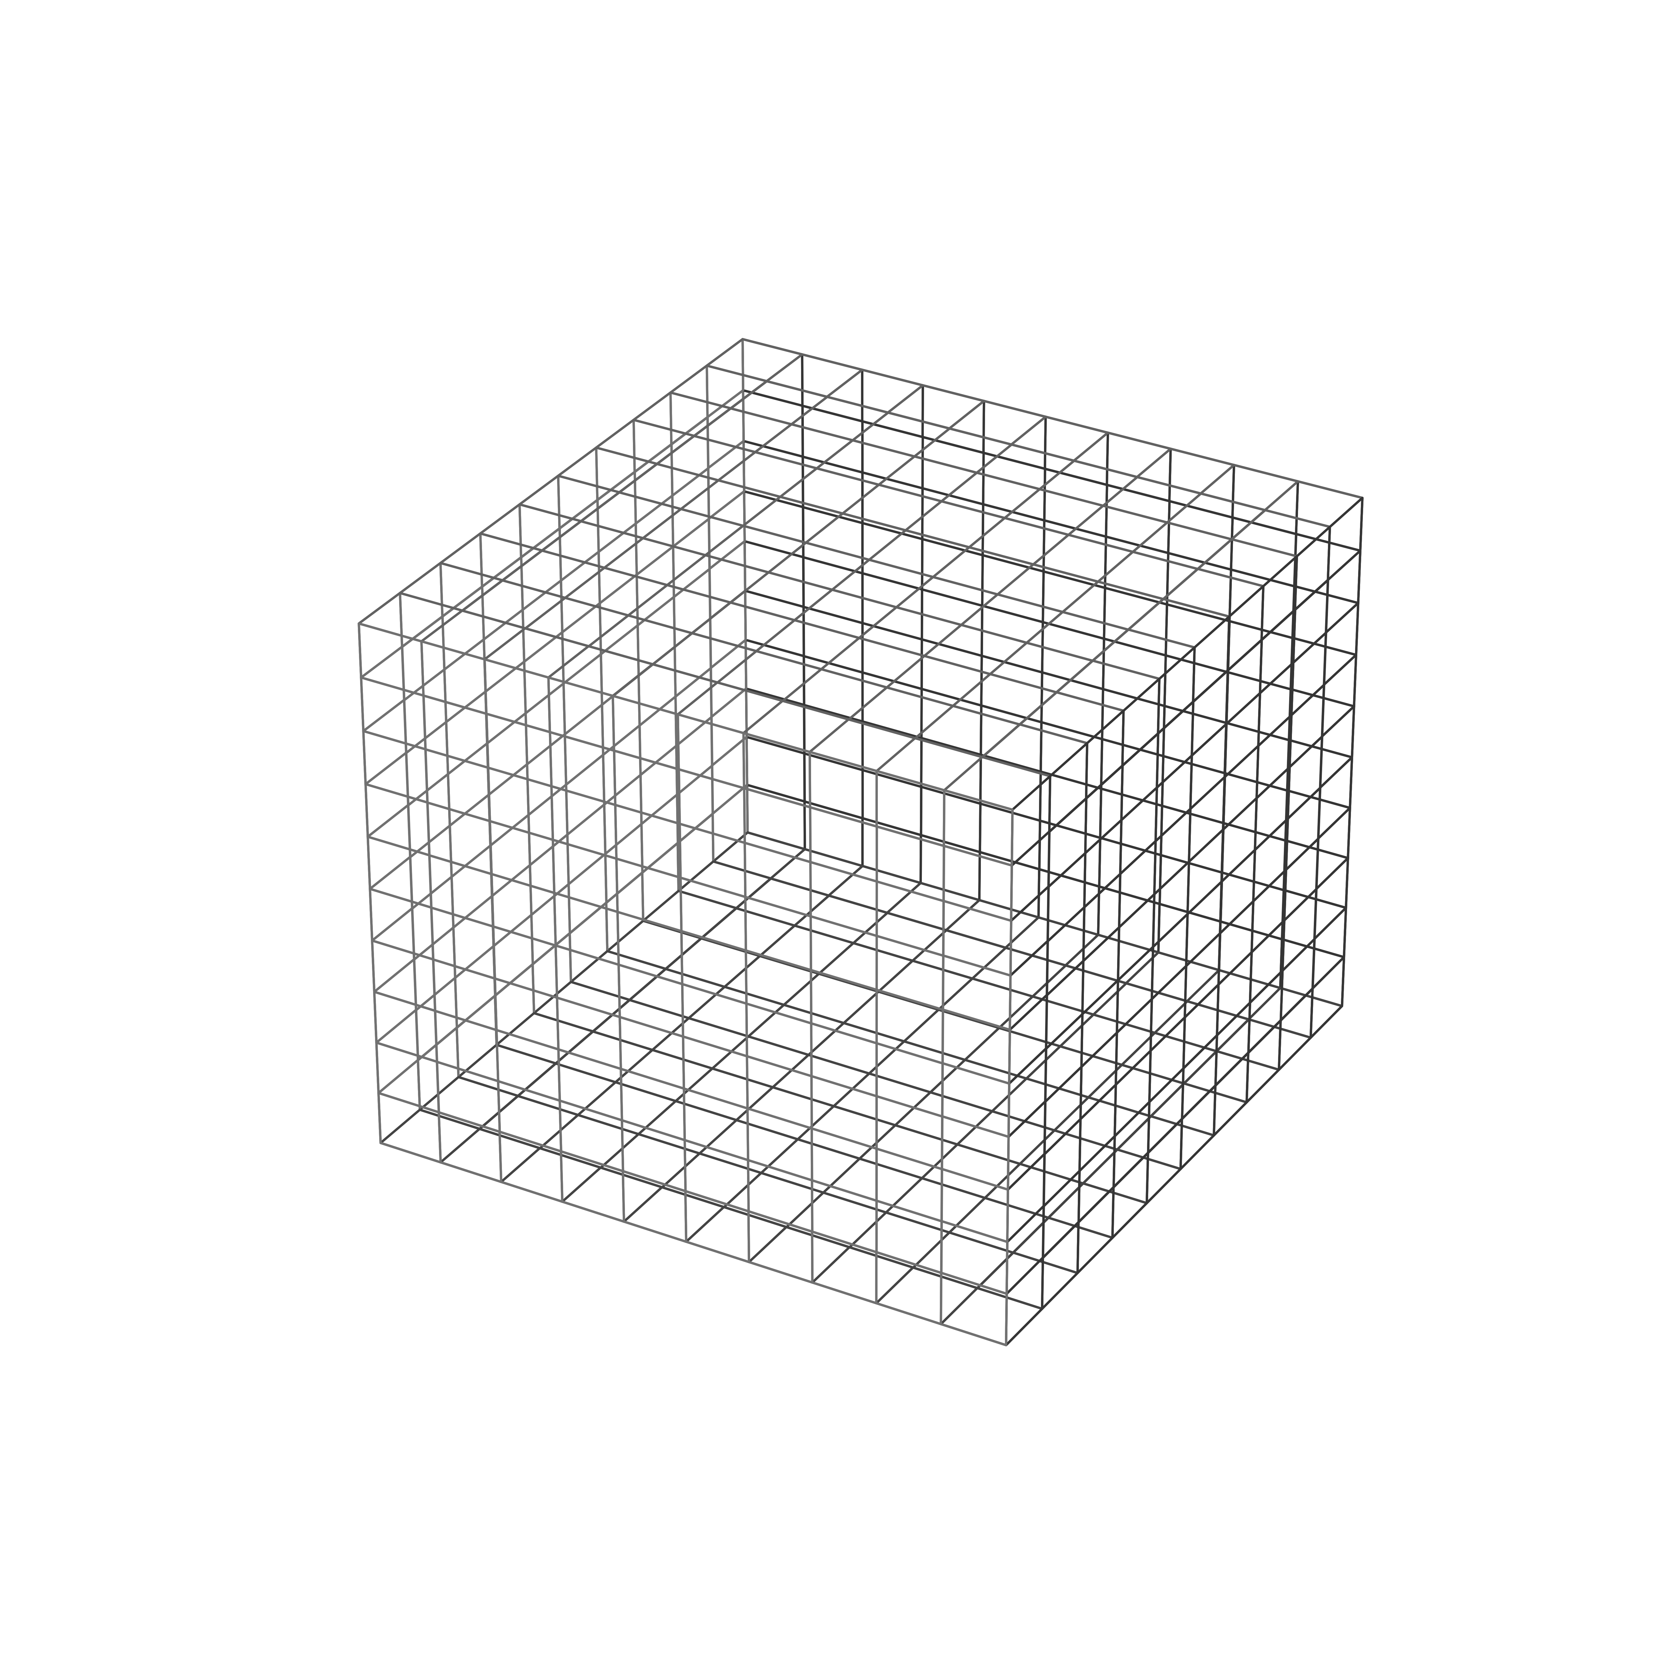
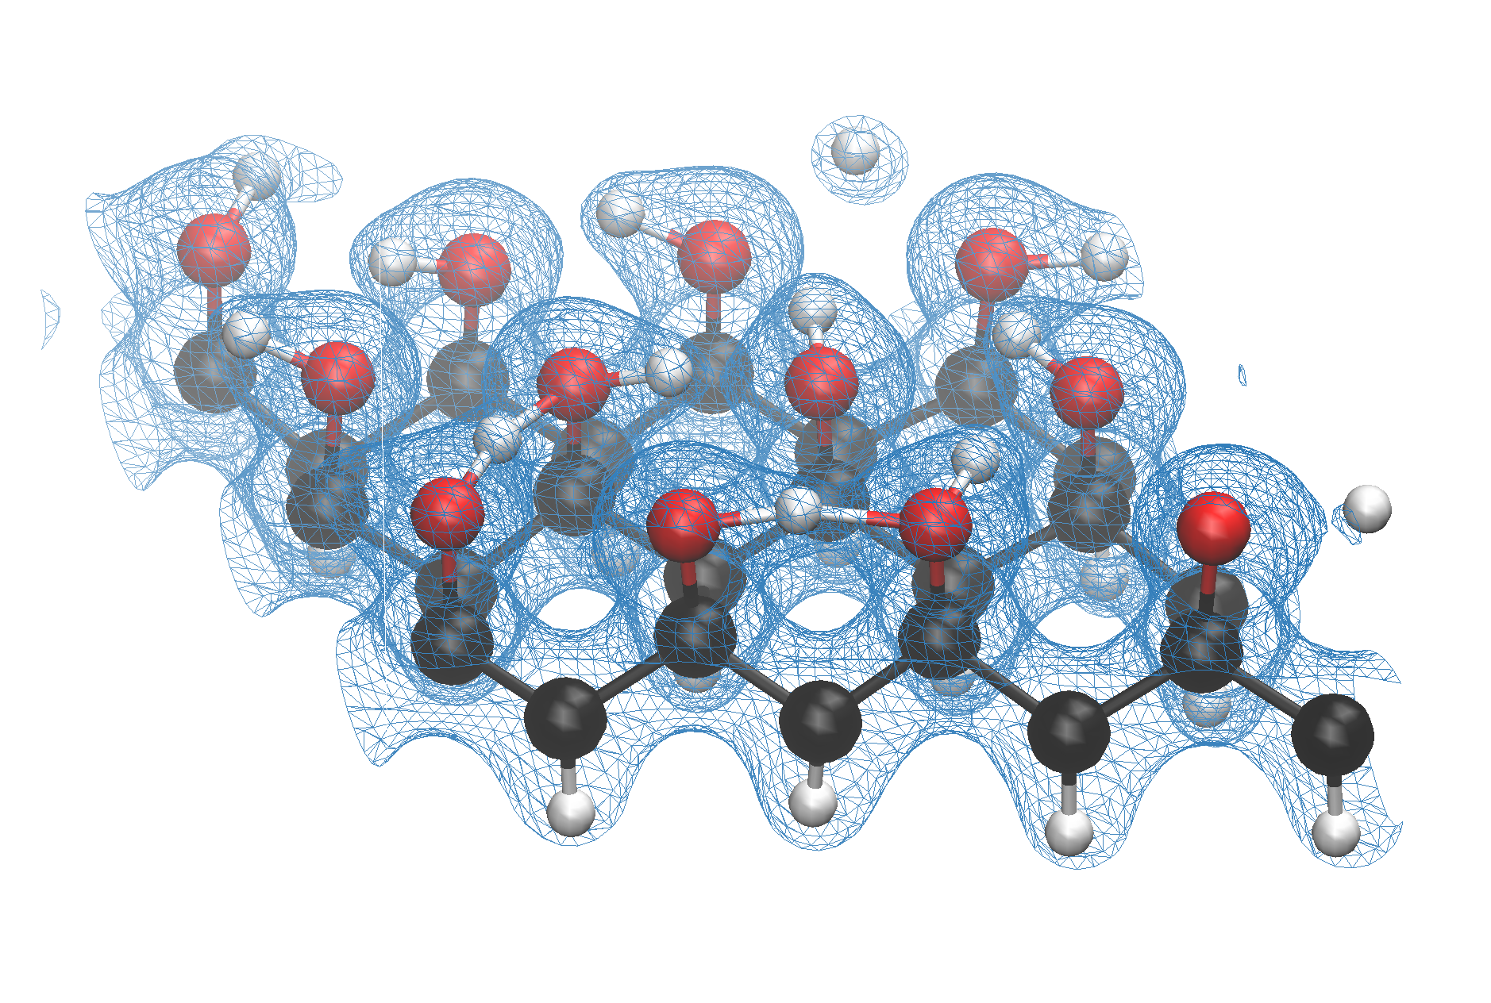

Slide 20
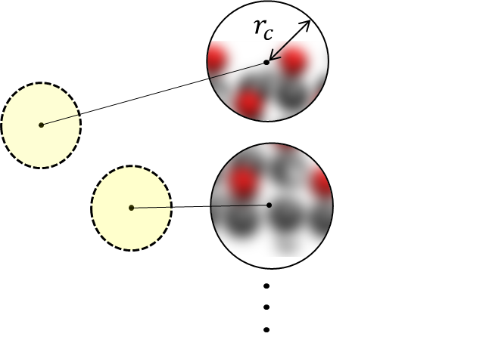
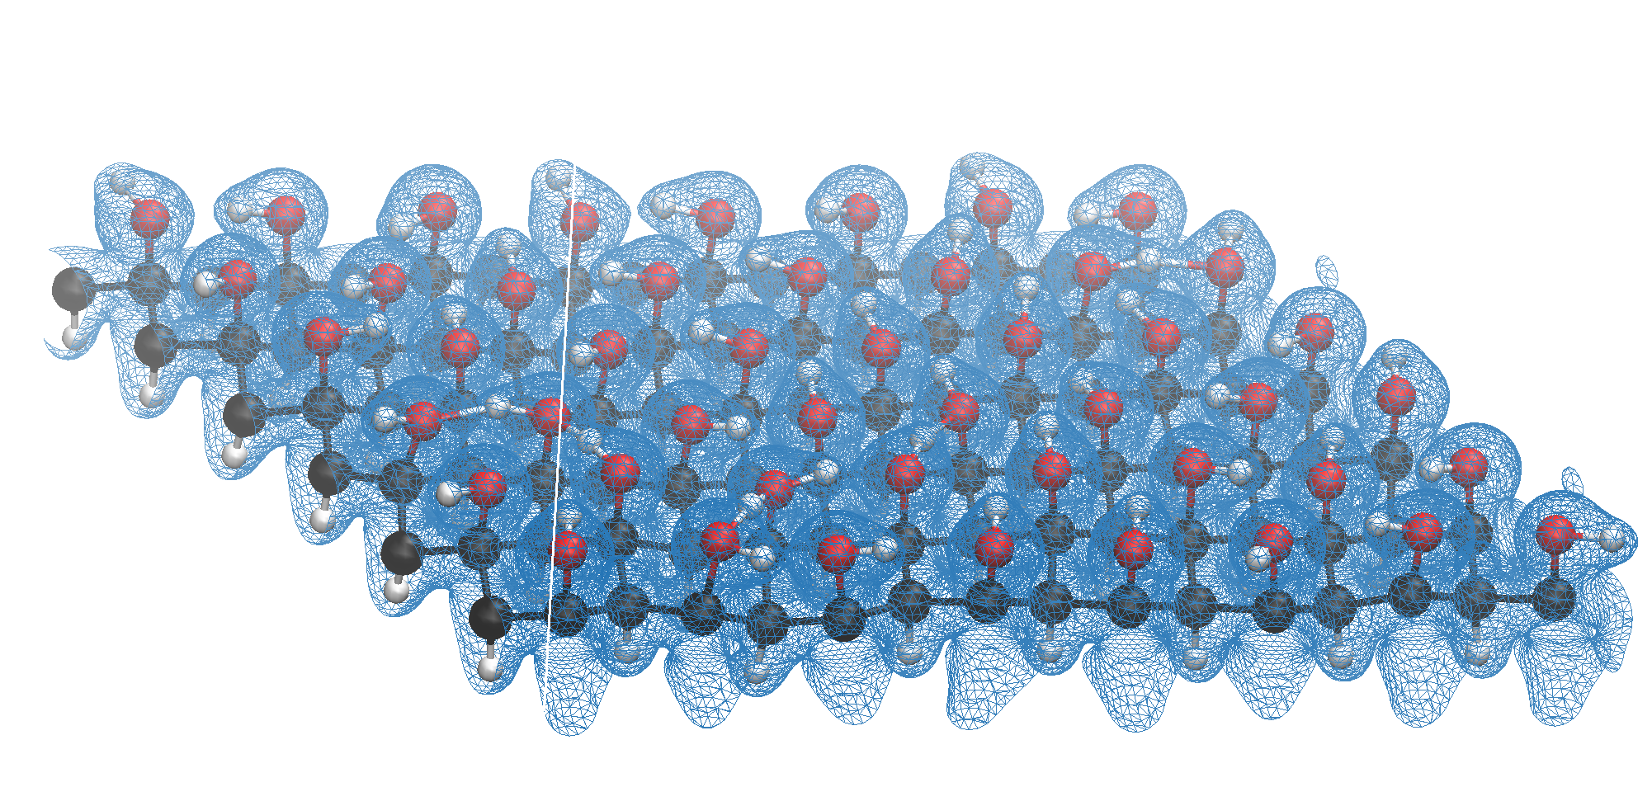
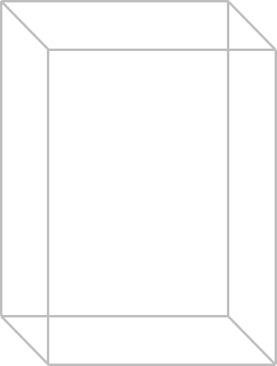
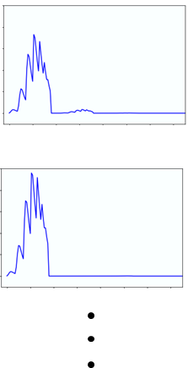
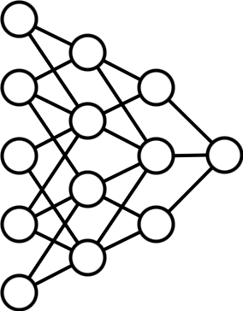
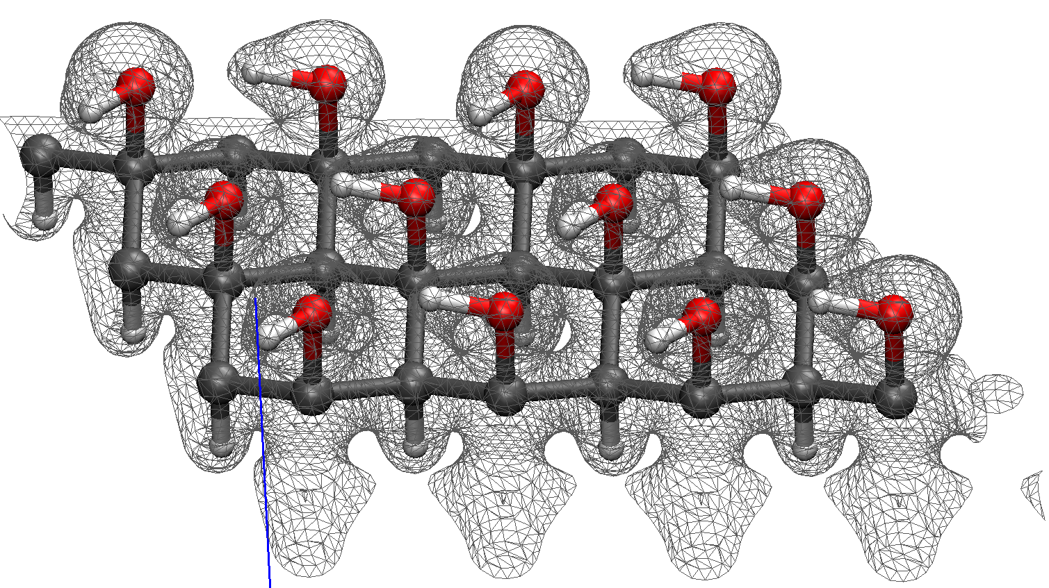
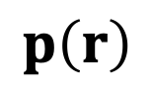
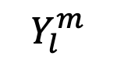
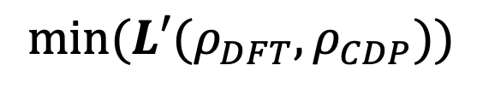
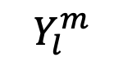
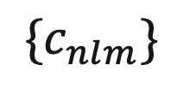
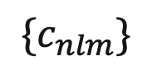
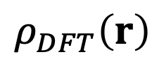
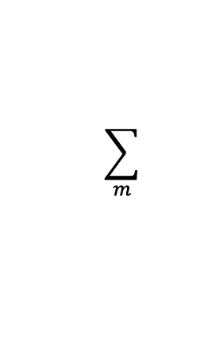
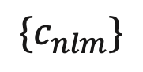
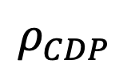
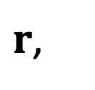
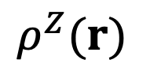

$$Y_{l}^{m}$$
$$\sum_{m}{ }$$
$${\{c}_{nlm}\}$$
$$Y_{l}^{m}$$
$$\sum_{m}{ }$$
$${\{c}_{nlm}\}$$
$r$,
$$ρ_{DFT}\left(r\right)$$
$$ρ^{Z}(r)$$
$${\{c}_{nlm}\}$$
$$p\left(r\right)$$
$$min(L′(ρ_{DFT},ρ_{CDP}))$$
$$ρ_{CDP}$$
Atomic coordinates and electron density from DFT
Expansion coefficients from atomic densities and spherical harmonics
Power spectrum vectors
Fitting neural network by minimizing loss function
Electron density prediction on test configurations

